Slide 1
UNMASKING
FINANCIAL FRAUD
By: Kanishk Goel
Comparing the Performance of Graph Neural Networks and Traditional Models Approaches

Slide 2
AGENDA
Introduction
Traditional ML Approaches
Why Graph Neural Networks?
Graph Architecture
Dataset
Experimental Setup
Results
Conclusion

Slide 3
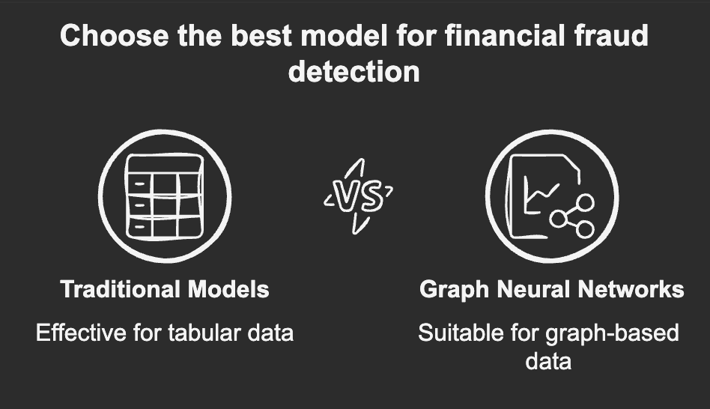
INTRODUCTION
Financial fraud is a growing issue, leading to billions of dollars in losses annually.
Credit card fraud is the most common form of identity theft
Impact of Fraud:
Erodes consumer trust.
Increases business operational costs.
Causes financial and legal challenges.
Affects economic stability.

Slide 4

CHALLENGES
Fraudsters are adaptive and change patterns
Hard to get real-world data
High imbalance in dataset
Multiple accounts or cards being used
The evolving complexity of fraud patterns.
The critical role of model explainability

Slide 5
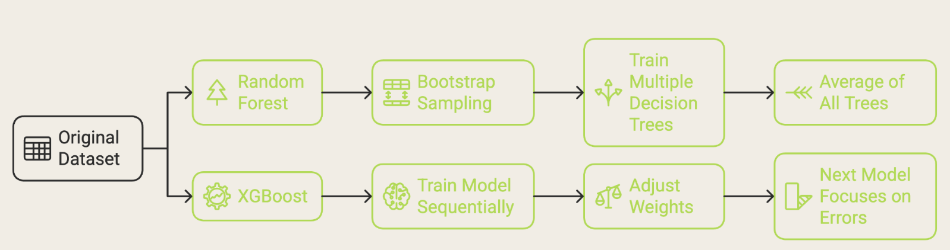
TRADITIONAL ML MODELS

Slide 6
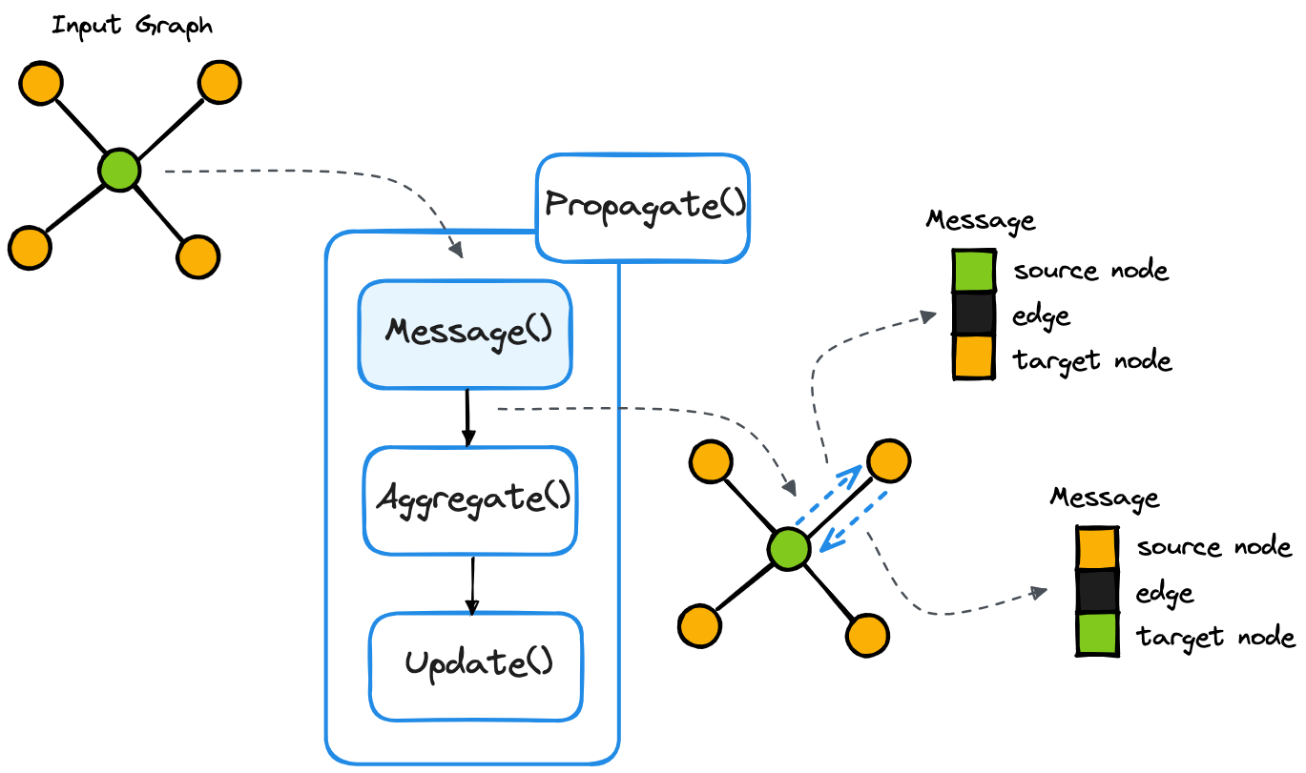
Why Graph Neural Networks
Transactions form a graph network
GNNs learn from node embeddings and edge interactions, capturing hidden fraud patterns
Traditional ML models treat transactions as independent instances, losing relational insights
GNNs are capable of processing vast volumes of data

Slide 7
Types of Graph
Homo-genous graph:
A homogeneous graph consists of only one type of node and one type of edge.
Simpler to train but does not capture different entity roles in the graph.
Eg. Social Network Analysis: Nodes represent users, edges represent friendships.
Hetero-genous graph:
A heterogeneous graph consists of multiple types of nodes and edges, capturing more complex relationships.
More complex but captures richer relationships.
Implemented by HeteroGCN
Eg. Financial Fraud Detection: Nodes represent Customers, Merchants, Transactions.

Slide 8
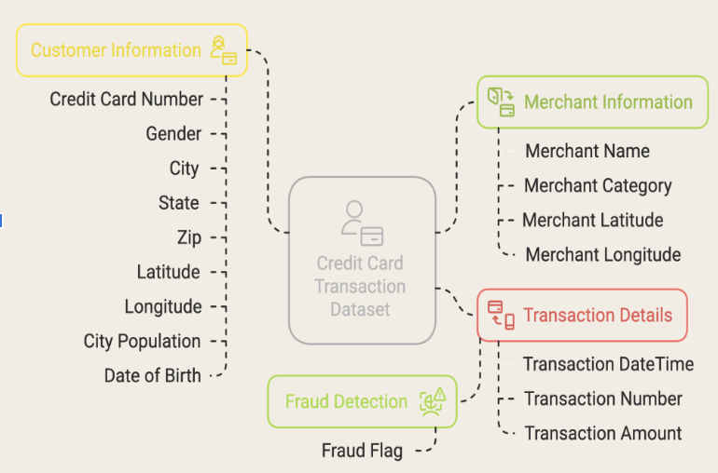
DATASET
Simulated credit card transaction dataset containing transactions from the duration 1st Jan 2019 - 31st Dec 2020.
Covers credit cards of 1000 customers doing transactions with a pool of 800 merchants.
Generated using Sparkov Data — Github tool created by Brandon Harris.

Slide 9
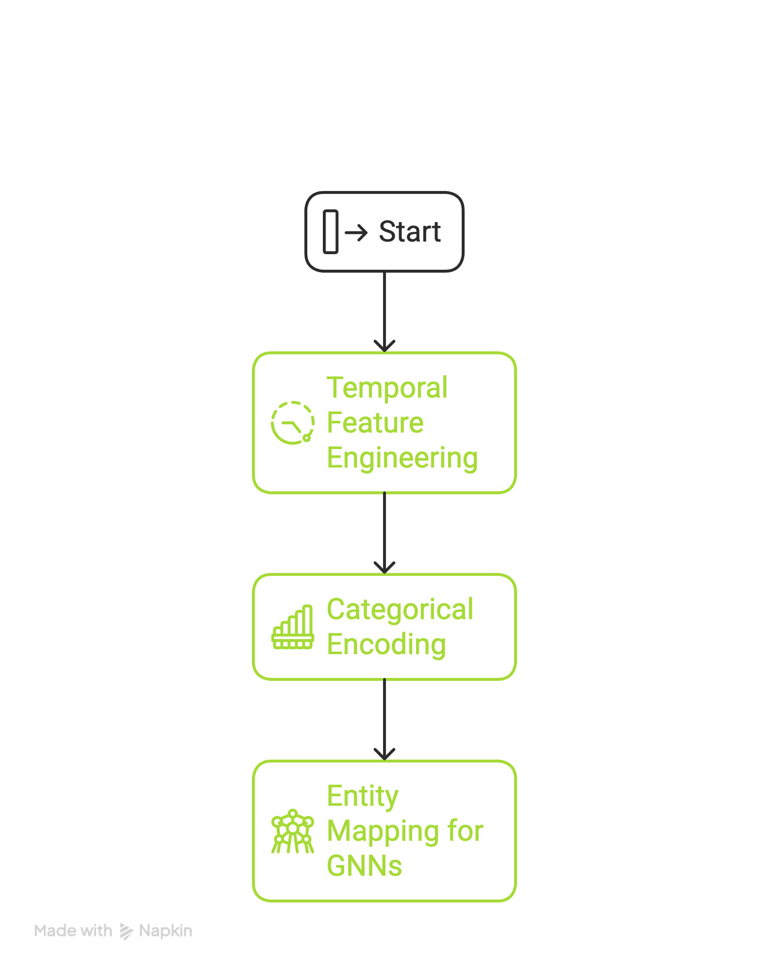
DATA PREPROCESSING
- Converted timestamp to datetime format. - Extracted hour and day for temporal analysis. - Applied sinusoidal encoding to preserve cyclic patterns
- One-Hot Encoding: for low-cardinality features (e.g., device type). - Label Encoding: for ordinal relationships (e.g., city size). - Target Encoding: for high-cardinality features like merchant category
- Essential for creating Heterogeneous Graph using PyTorch Geometric

Slide 10
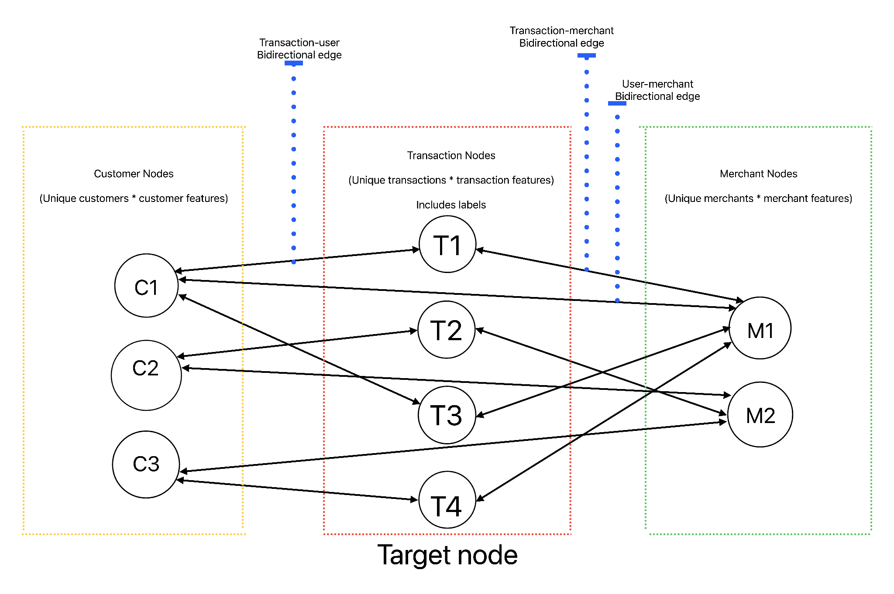
GRAPH
STRUCTURE
Transaction nodes: 1296675
Merchant nodes: 693
Customer nodes: 983
Edge type:
customer <–> merchant: 479072
transaction <--> customer: 1296675
transaction <--> merchant: 1296675
transaction <--> transaction: 1296675

Slide 11
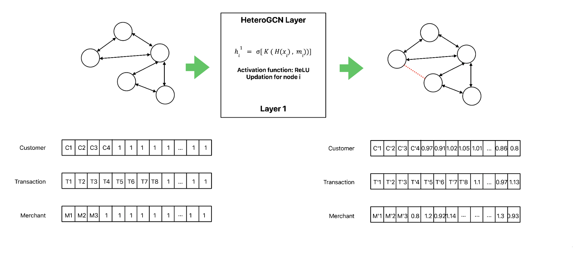
GNN Architecture

Slide 12
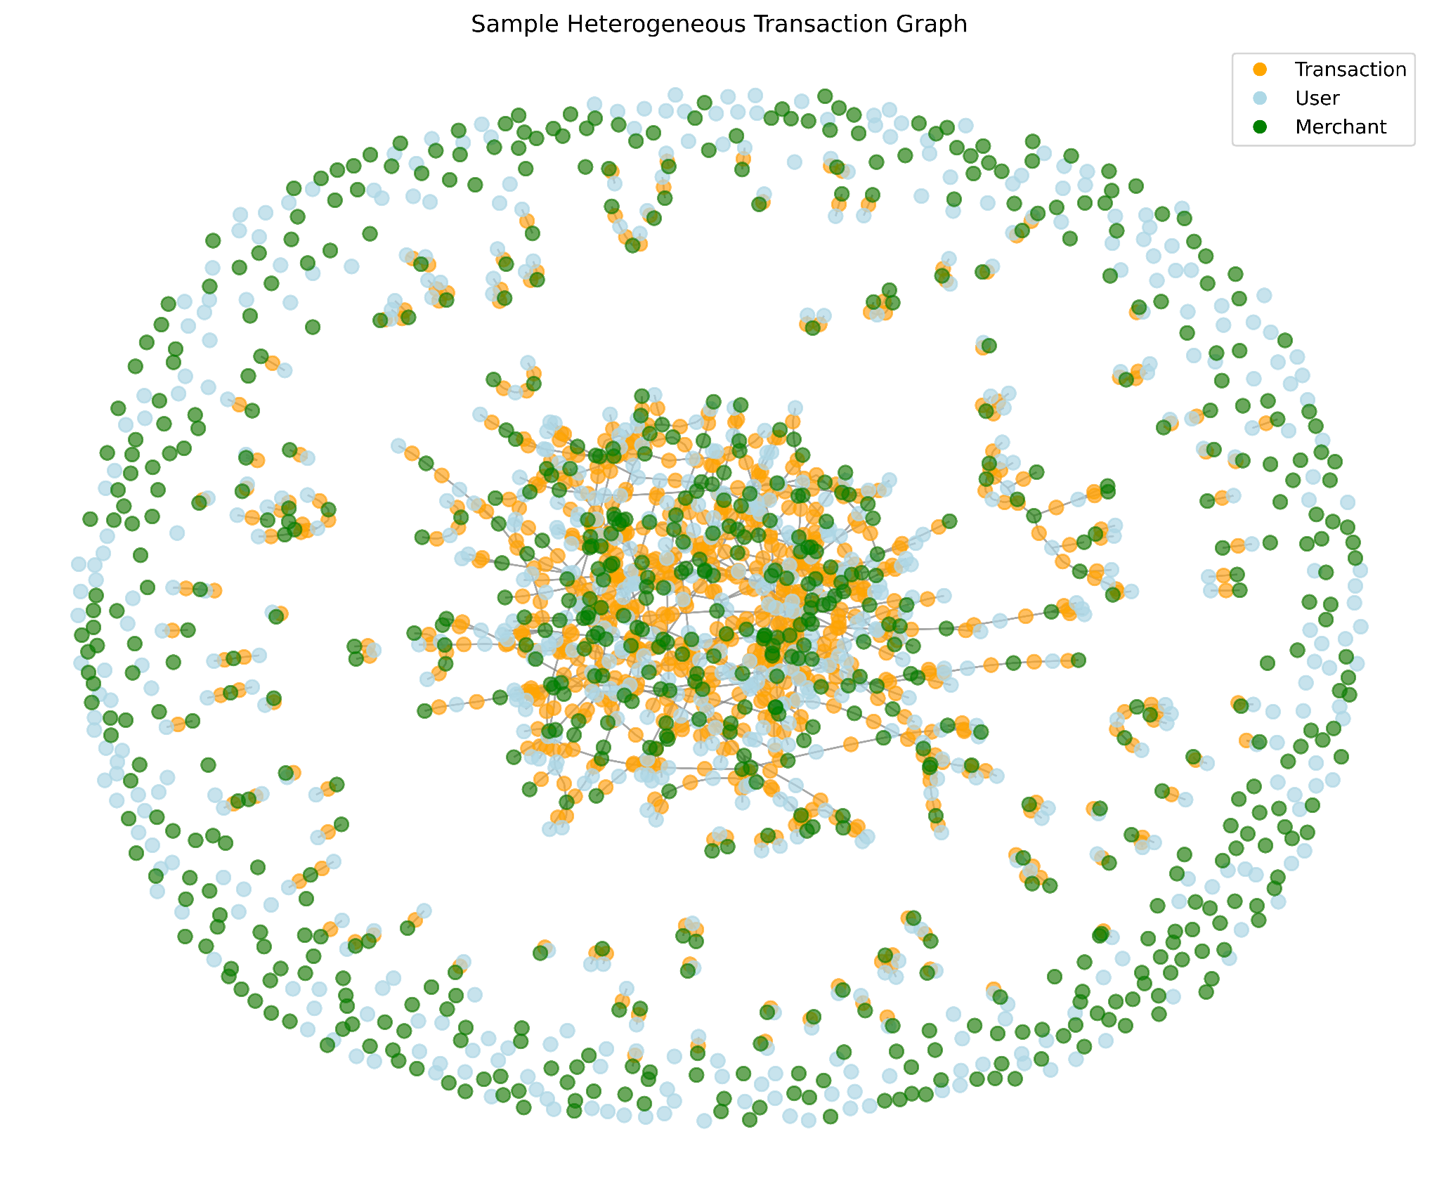
EXPERIMENTAL SETUP
Used 4 HeteroConv layers with GraphSAGE
Embedding size of 32
AWS EC2 - G5.2xlarge with 32 gb memory and GPU Accelerated due to millions of records
Batch size of 128 yield best results with 60 epochs
Used early-stopping with patience = 10 is used to avoid overfitting

Slide 13
EVALUATION METRICS
AUC-PR: measures the model’s ability to correctly identify the positive class (fraud) across all threshold.
F1-score: balances the trade-off between precision and recall, and is especially useful when both false positives and false negatives have significant consequences

Slide 14
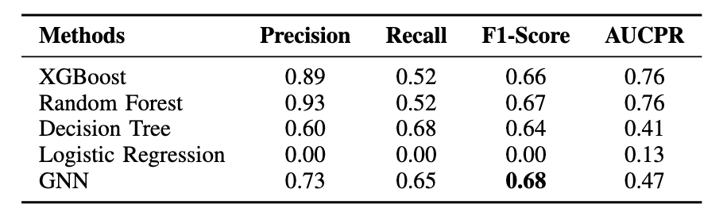
RESULTS

Slide 15
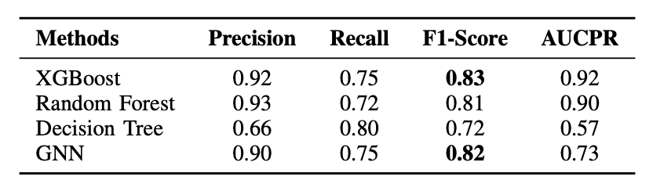

Slide 16
CONCLUSION
GNNs outperform classical models when relational structures dominate and feature engineering is limited.
Heterogeneous message passing (users, merchants, transactions) boosts fraud detection performance.
In Dataset 2, classical models (XGBoost, Random Forest) slightly outperformed due to strong, explicit features.
GNNs excel in relationally complex, feature-sparse environments.
Classical models remain strong when features are rich and well-crafted.

Slide 17
FEEDBACK!

